Slide 1
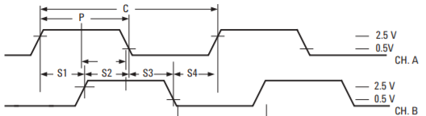
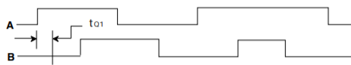
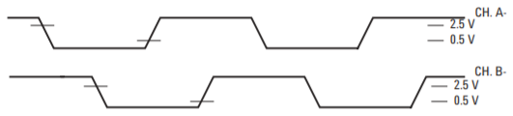
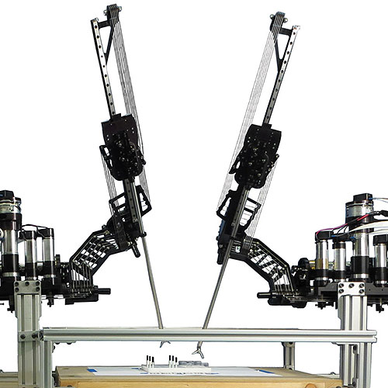
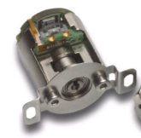

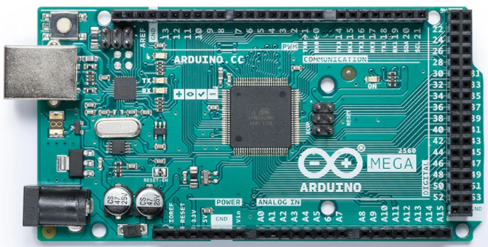
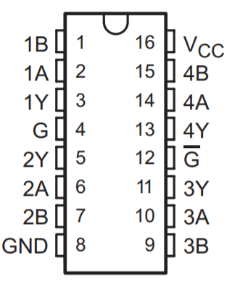
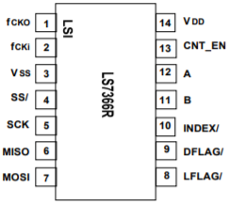

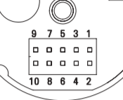
1,2,3,… (digital counts)
RAVEN II Robot
3 - Vss
16 - Vcc
7 - Vcc
8 - Vcc
50 - MISO
6
1 - 1A
1 - A+
Arduino Mega 2560
LS7366R
Quadrature Counter with Serial Interface
AM26C32
Quadruple Differential Line Receiver
51 - MOSI
7
12 - A
3 – 1Y
R_{T} =240Ω
52 - SCK
5
2 - 1B
2 - A-
1,2,3,…
HBCU-5710r
Optical Incremental Encoder
53 - SS
4
Python Serial
11 - B
5 – 2Y
6 - 2A
5 - B+
1 - f_{CKO}
R_{T} =240Ω
20MHz
7 - 2B
6 - B-
2 - f_{CKI}
3 - Gnd
4 - Gnd
14 - Vdd
8 - Gnd

Slide 2
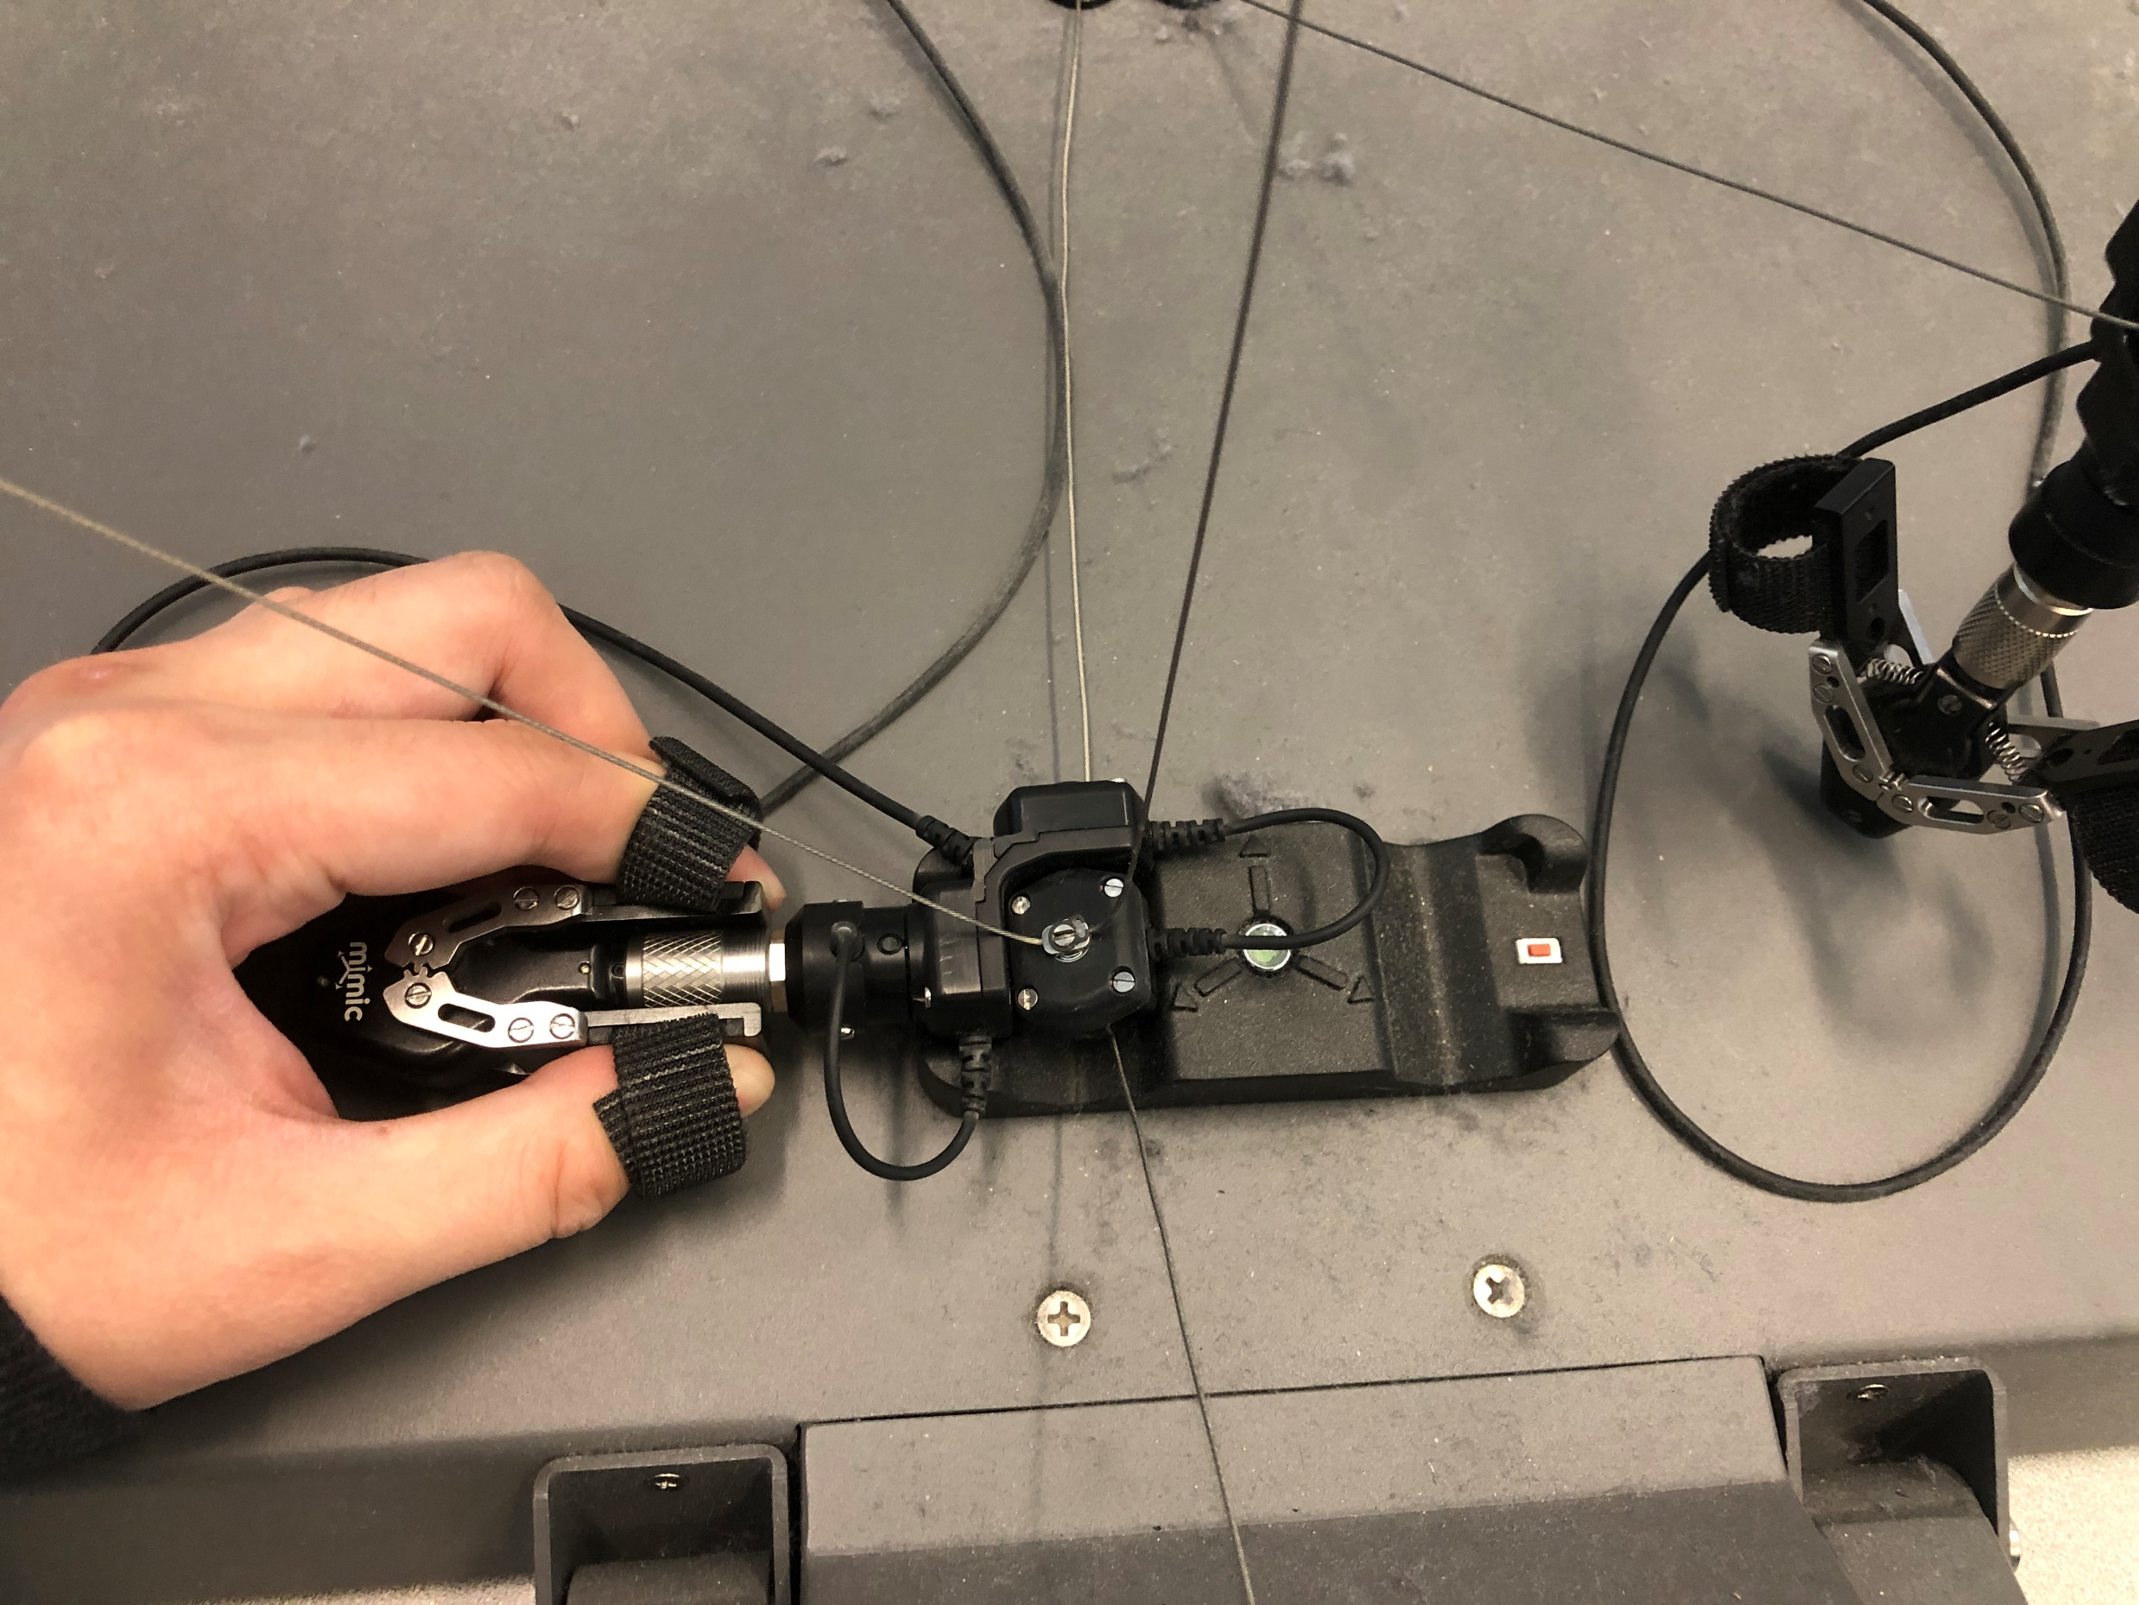

Slide 3
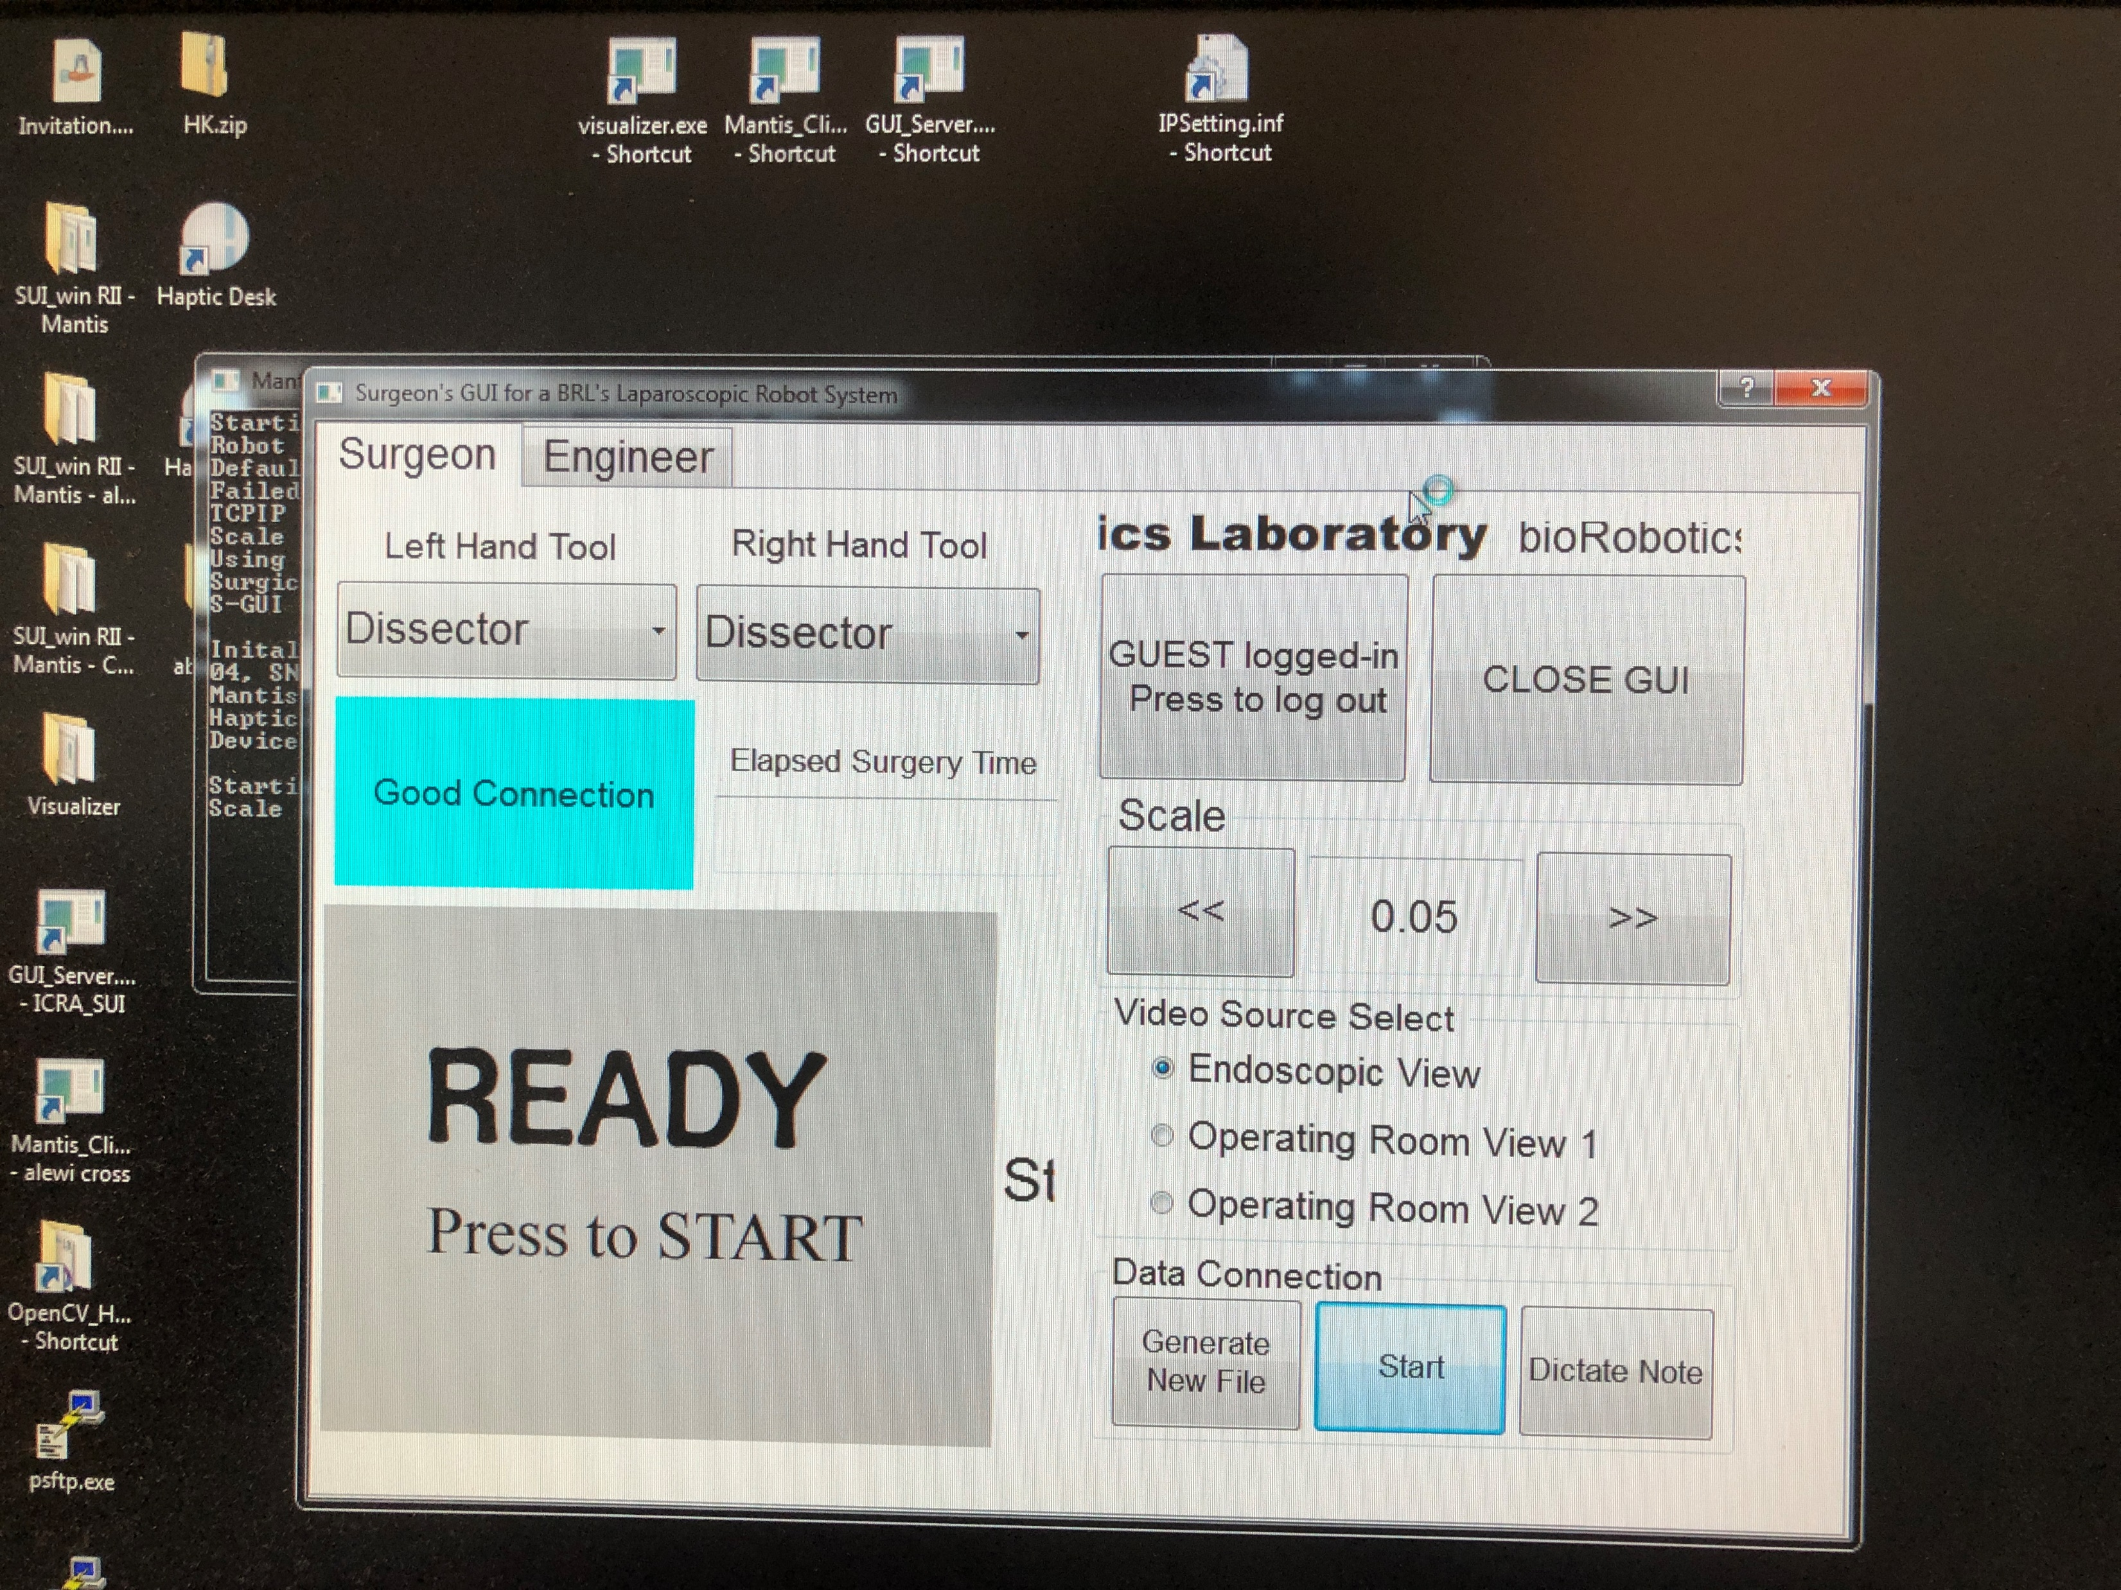

Slide 4
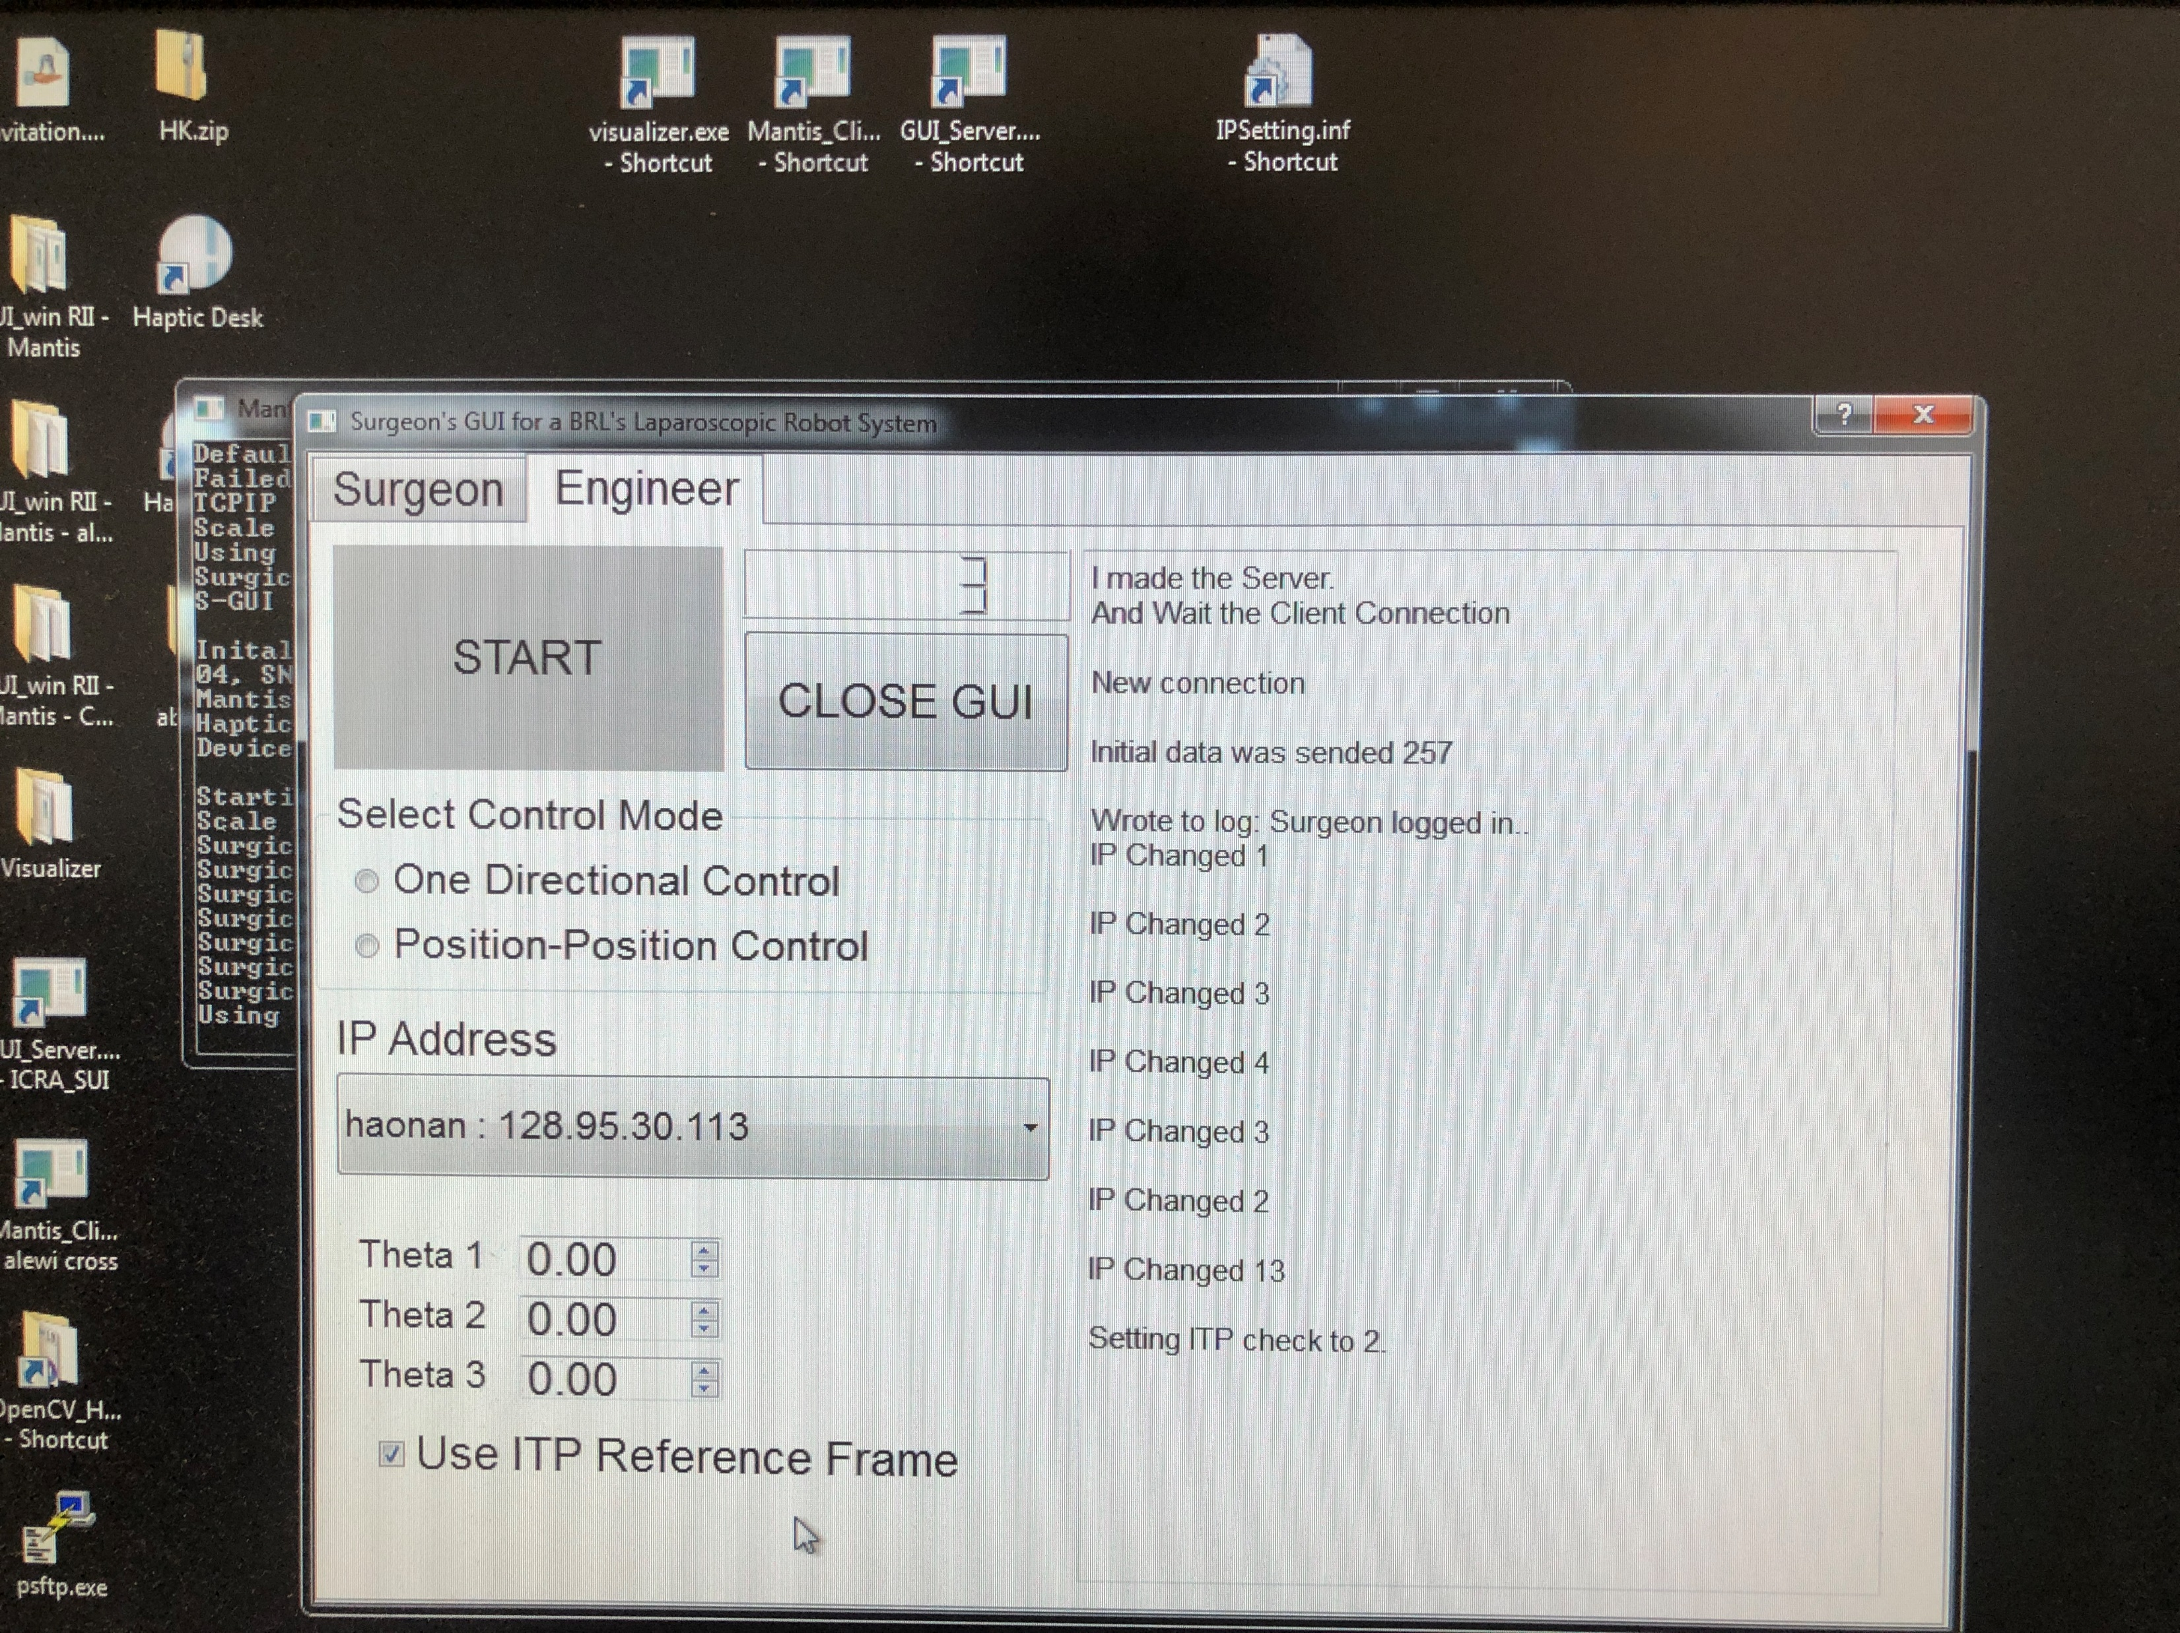

Slide 5
